Slide 1
Prioritizing synthetic lethal targets using comutation data
May 1, 2020

Slide 2
Model 1. Using comutation as a binary indicator
Model the effect of knocking out a gene using the following covariates:
RNA expression of the gene in each cell line (continuous)
Does the cell line have KRAS G12D (binary)
Is the gene mutated in the cell line (binary)
For each comutation interaction X with G12D:
Is gene X mutated? (binary)
Is gene X mutated and KRAS G12D? (binary; interaction)
gene_effect ~ RNA + is_mut + allele + … + X + … + allele:X + …

Slide 3
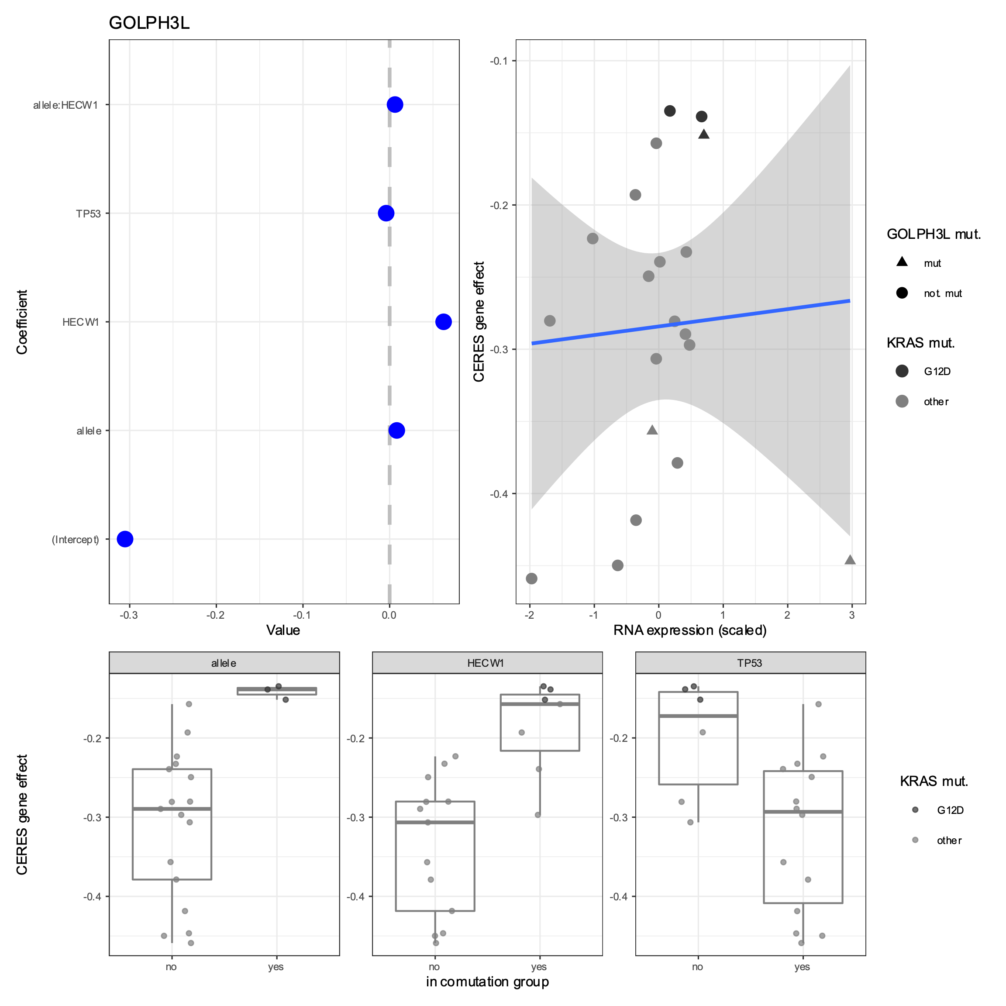

Slide 4
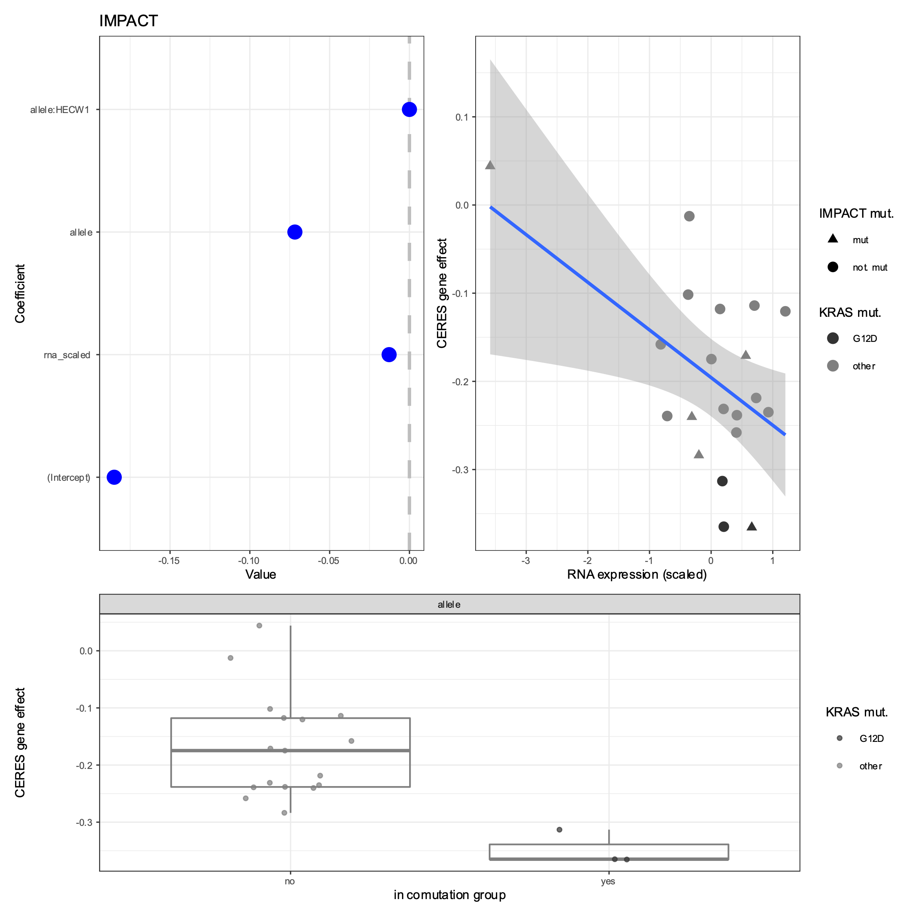

Slide 5
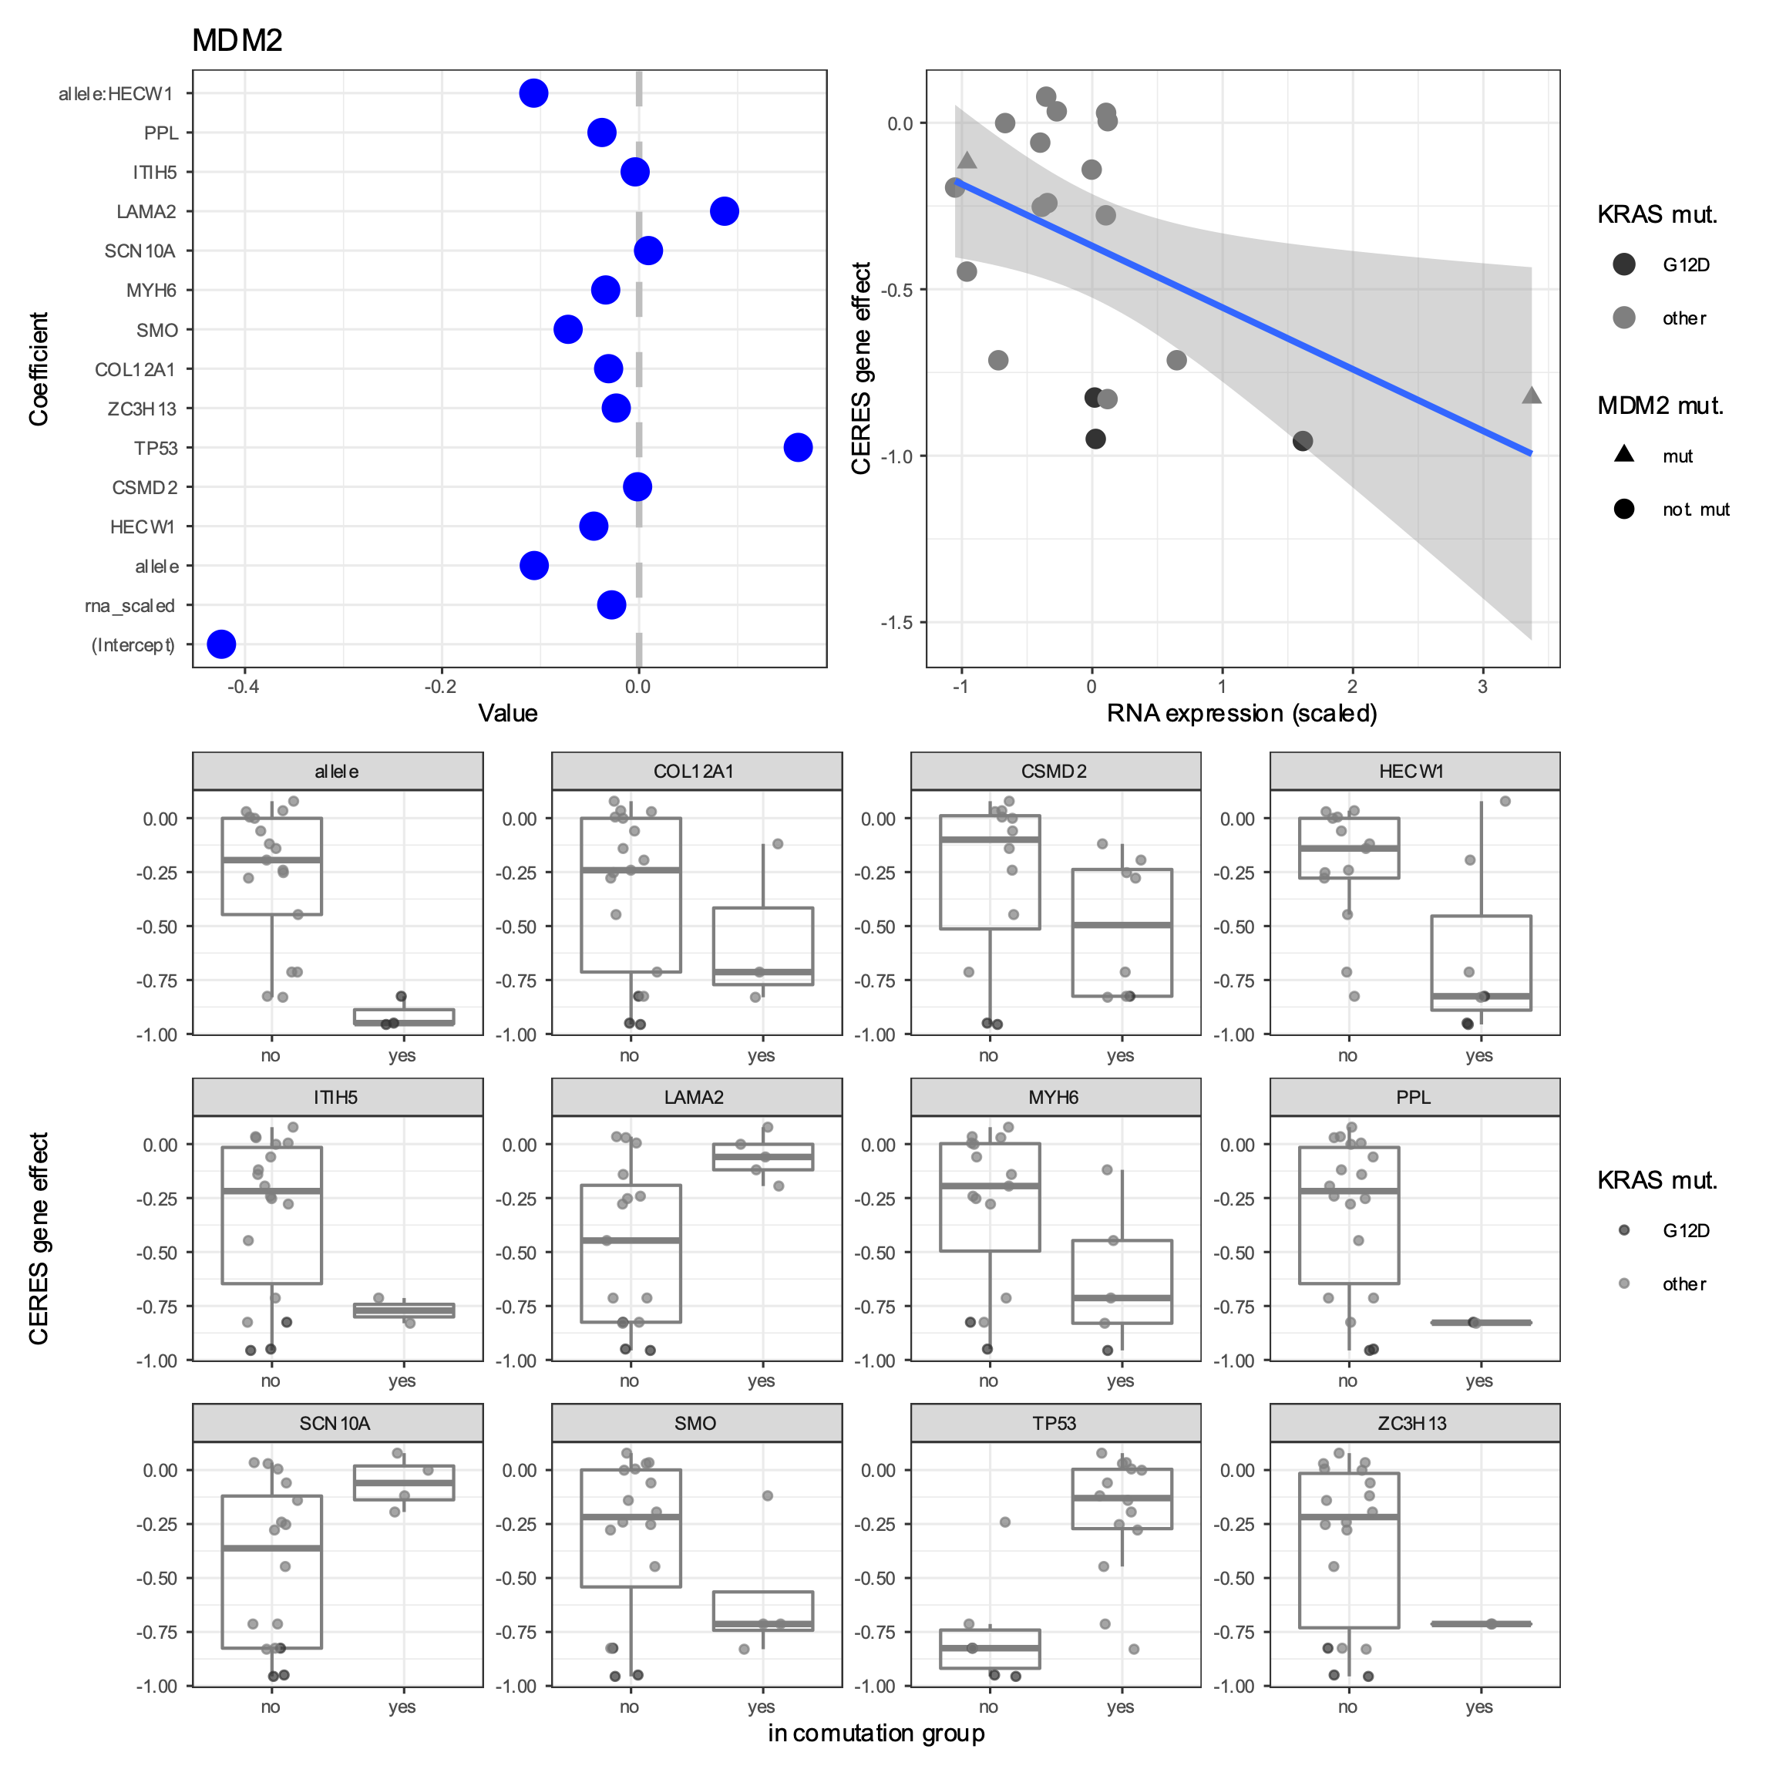

Slide 6
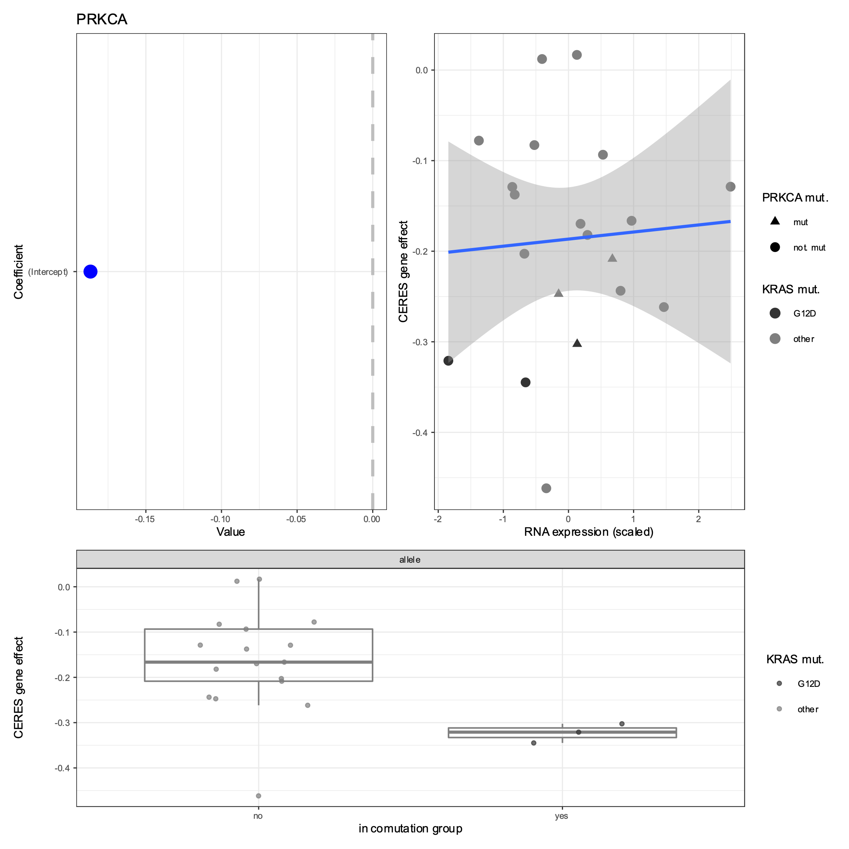

Slide 7
Model 2. Using dependency of comutating genes
Model the effect of knocking out a gene using the following covariates:
RNA expression of the gene in each cell line (continuous)
Does the cell line have KRAS G12D (binary)
Is the gene mutated in the cell line (binary)
For each comutation interaction X with G12D:
Effect of knocking out gene X in each cell line (continuous)
gene_effect ~ RNA + is_mut + allele + … + gene_effect_{X} + …

Slide 8
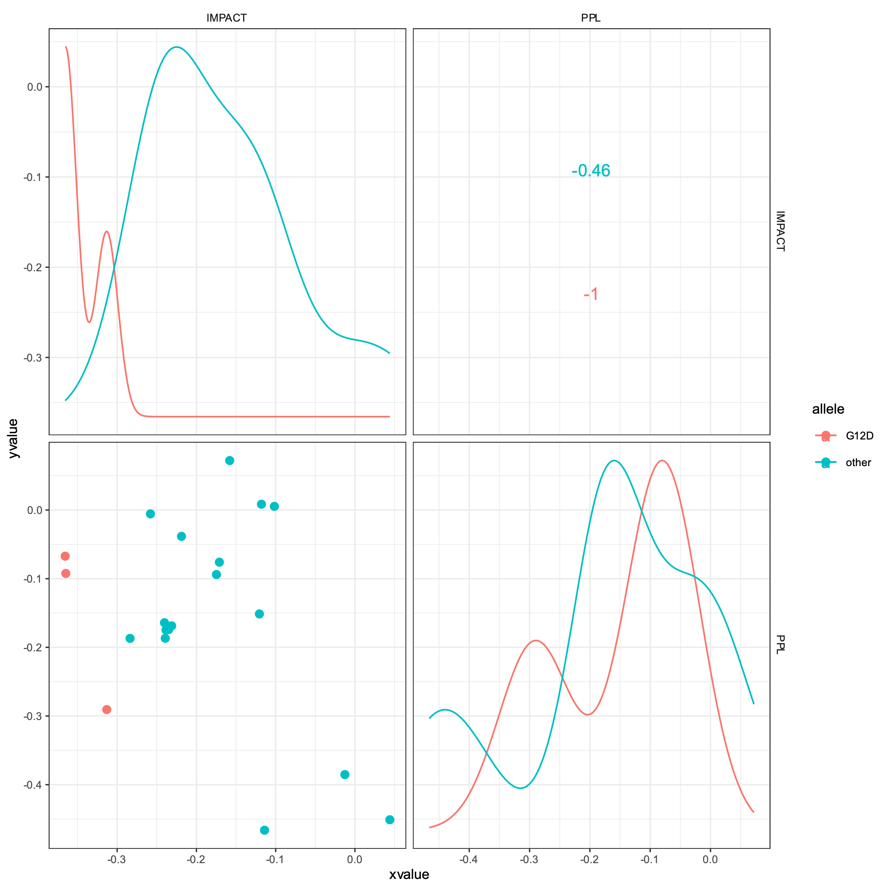
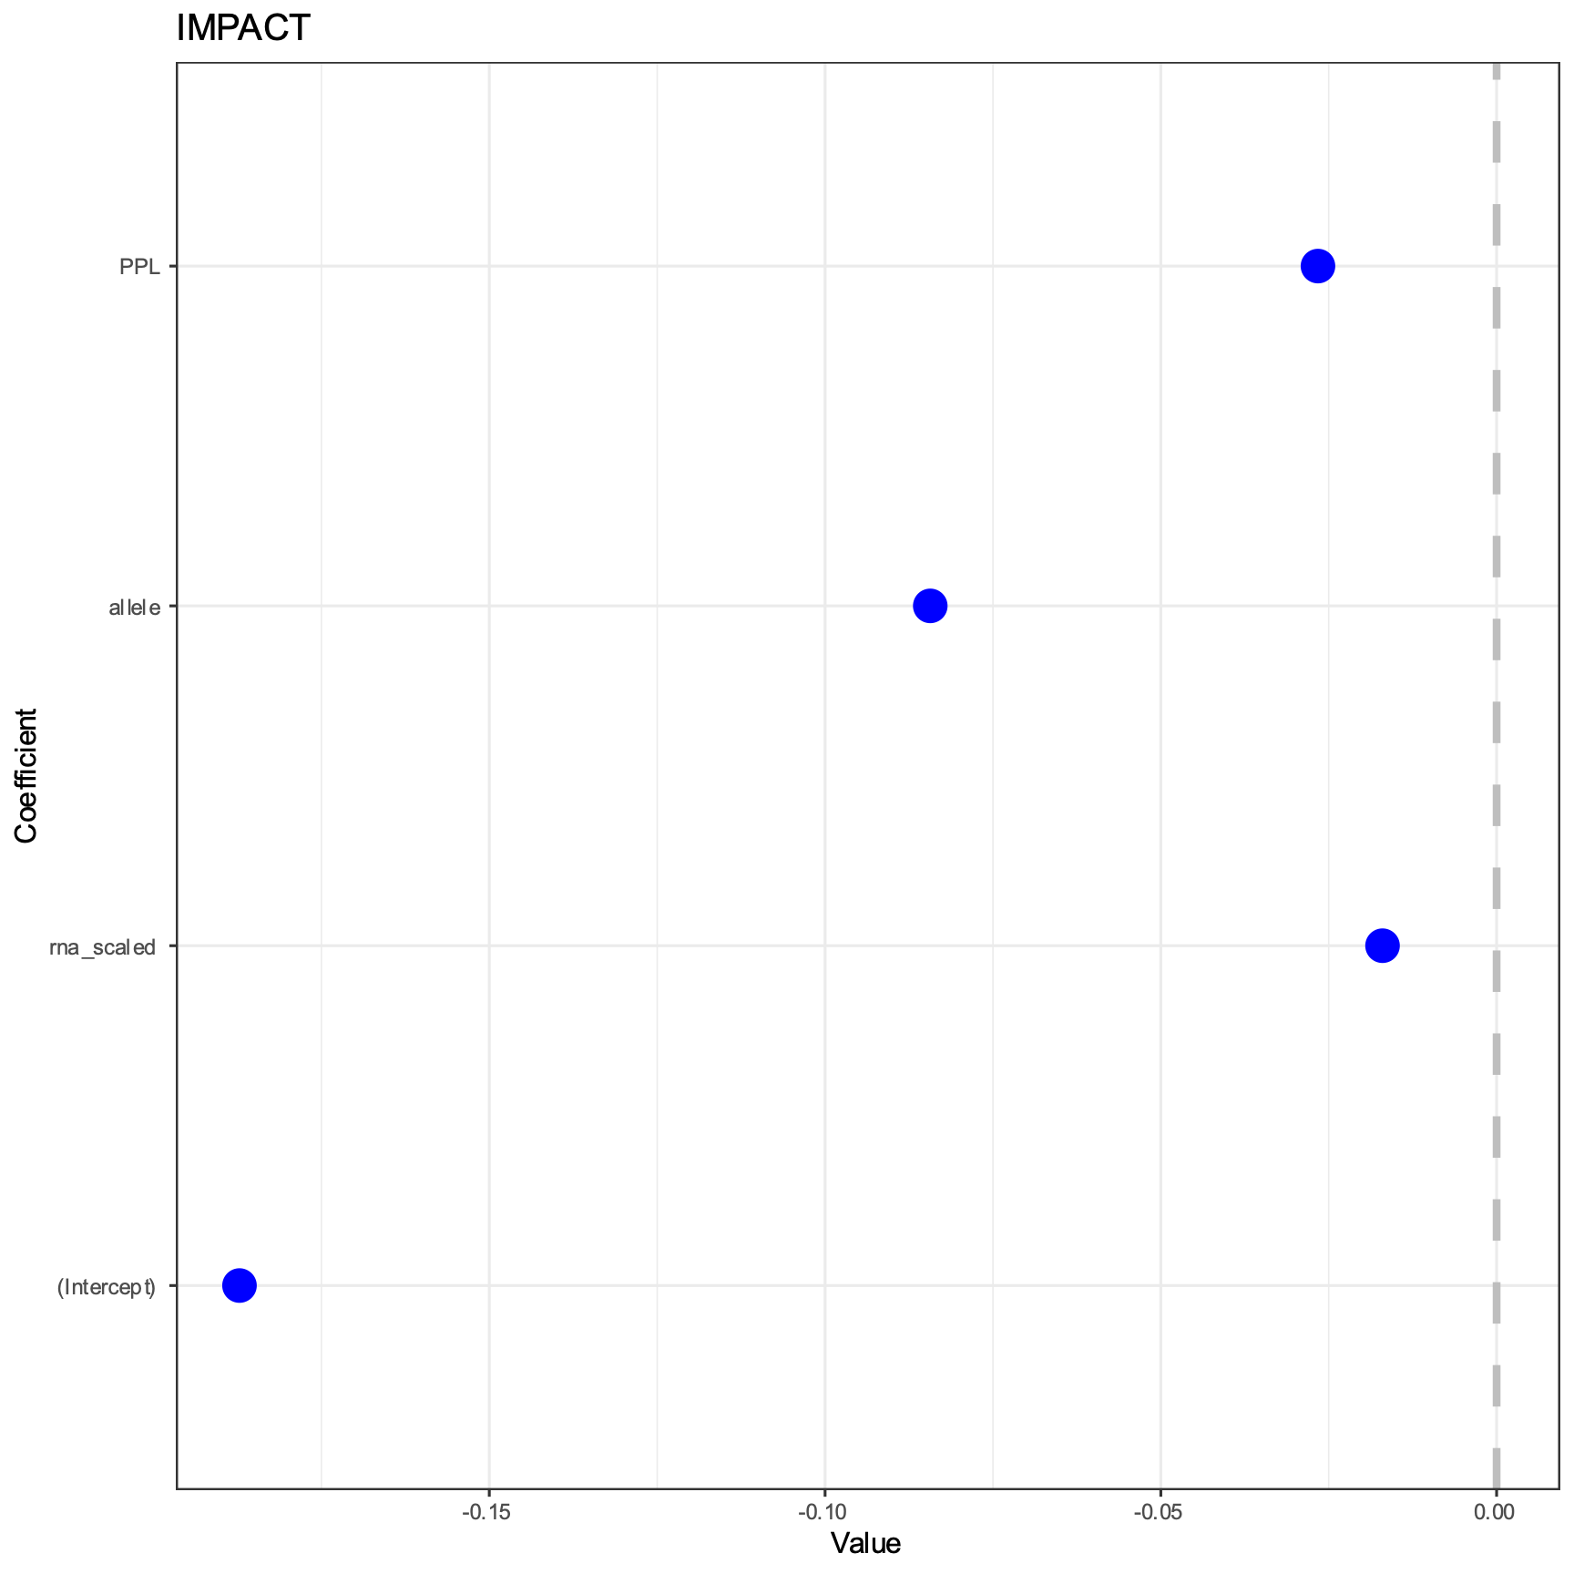

Slide 9
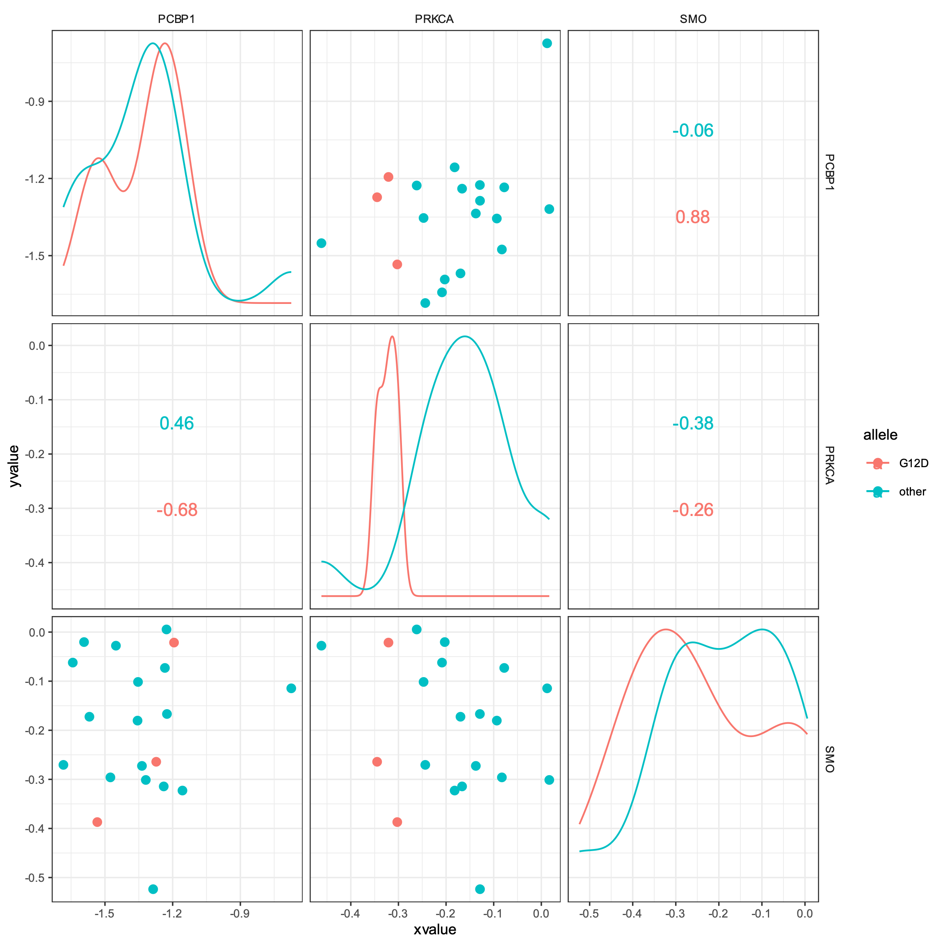
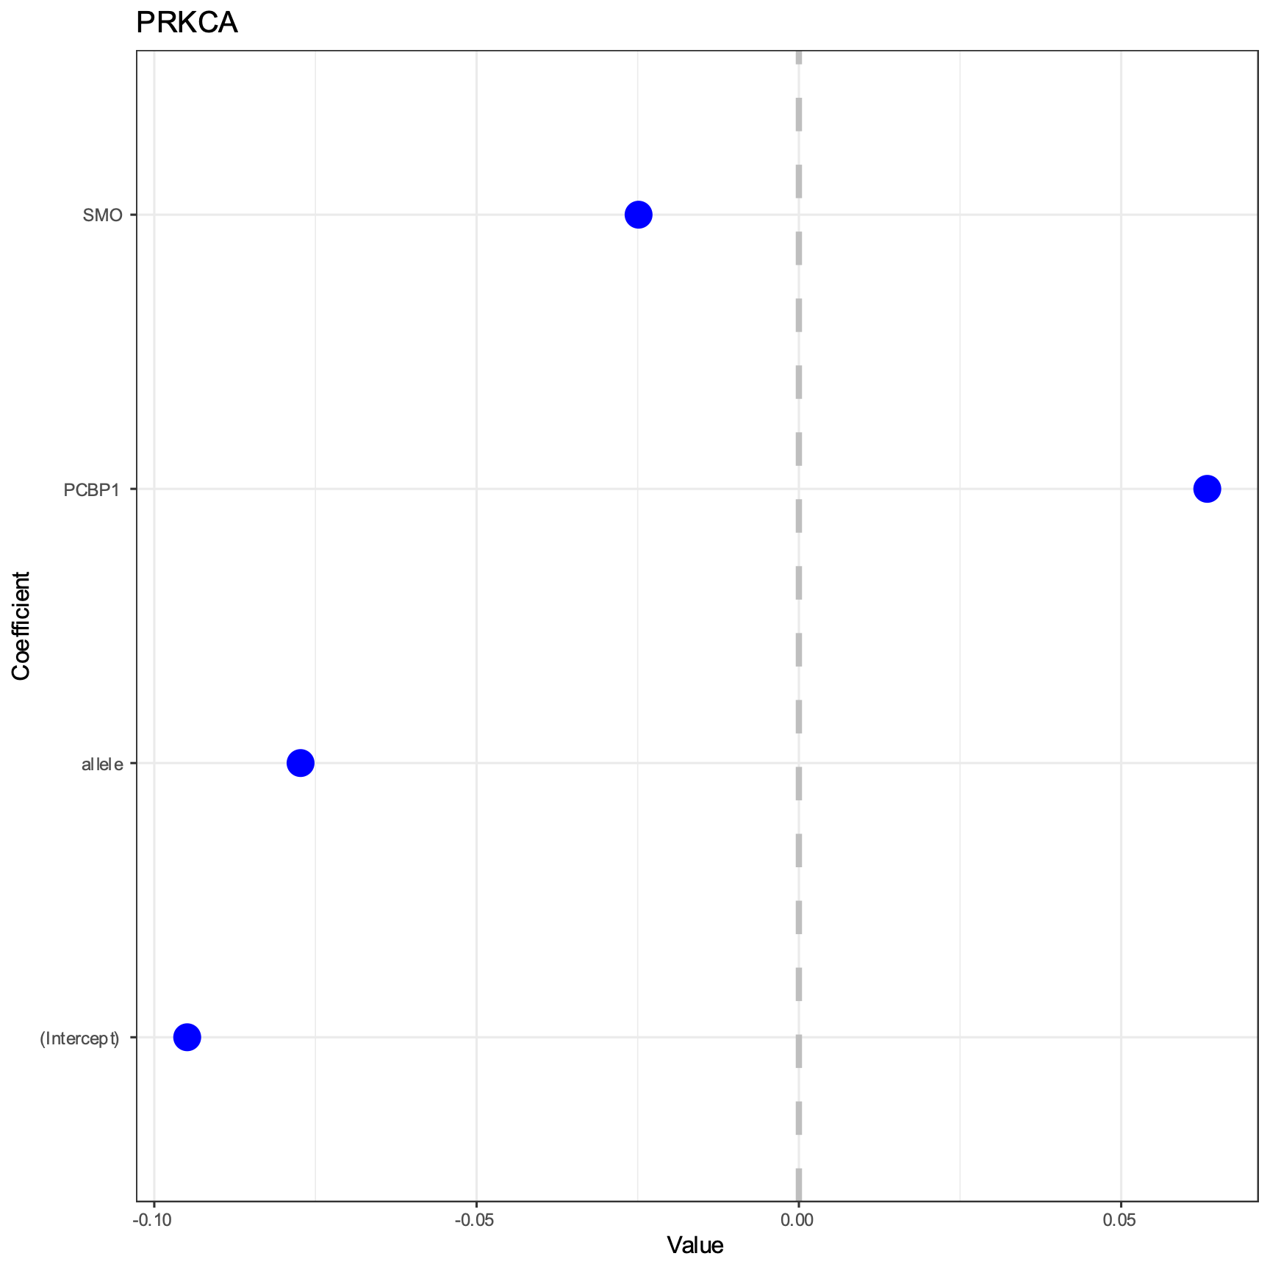

Slide 10
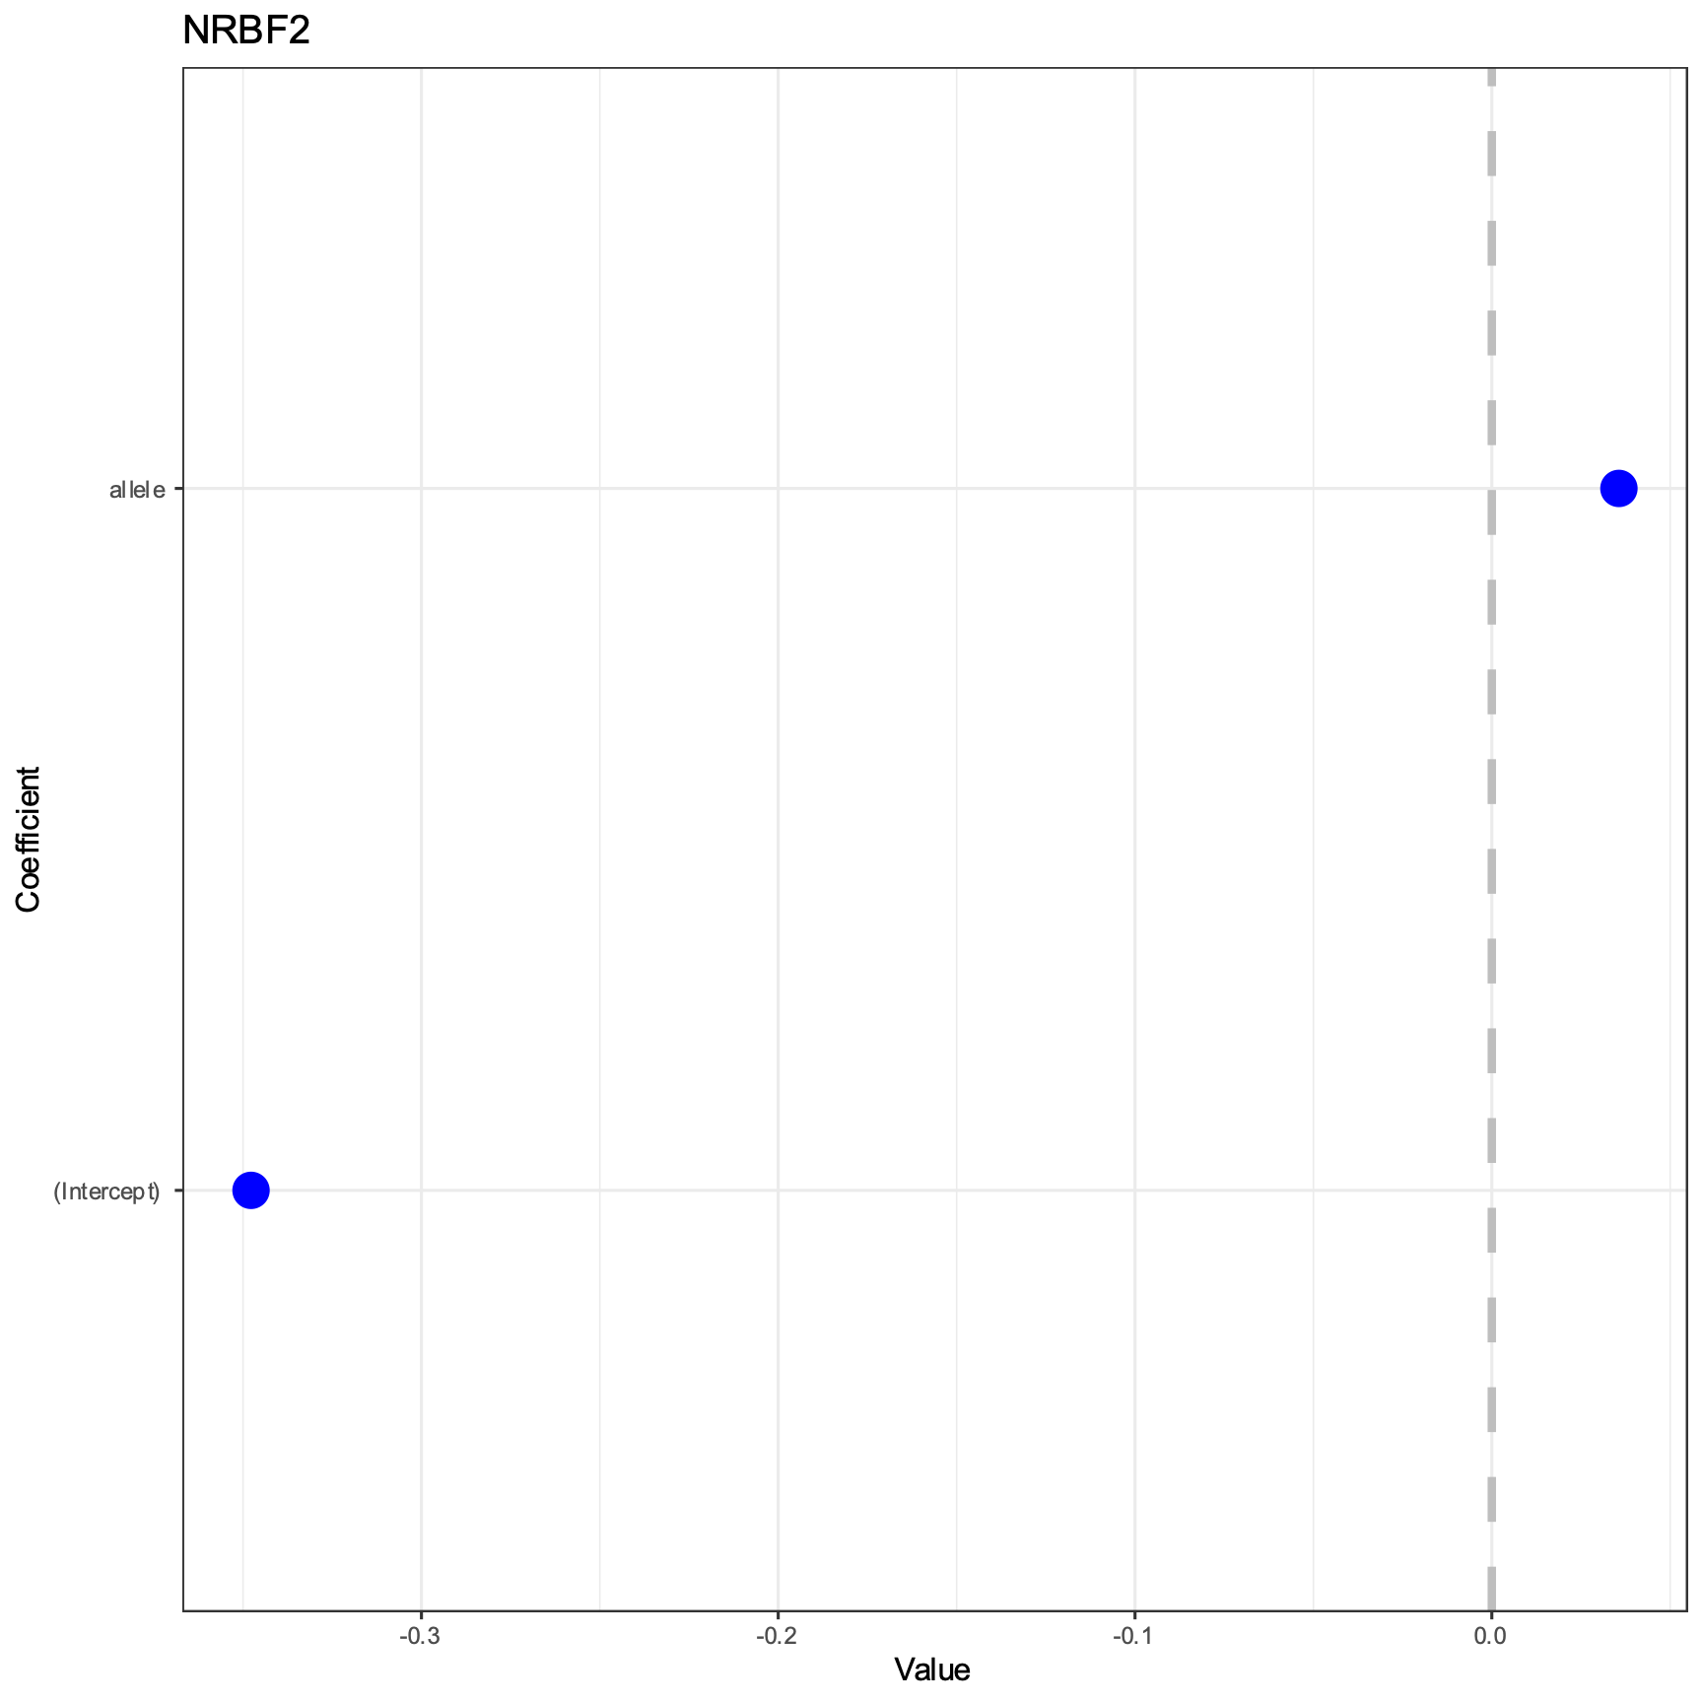

Slide 11
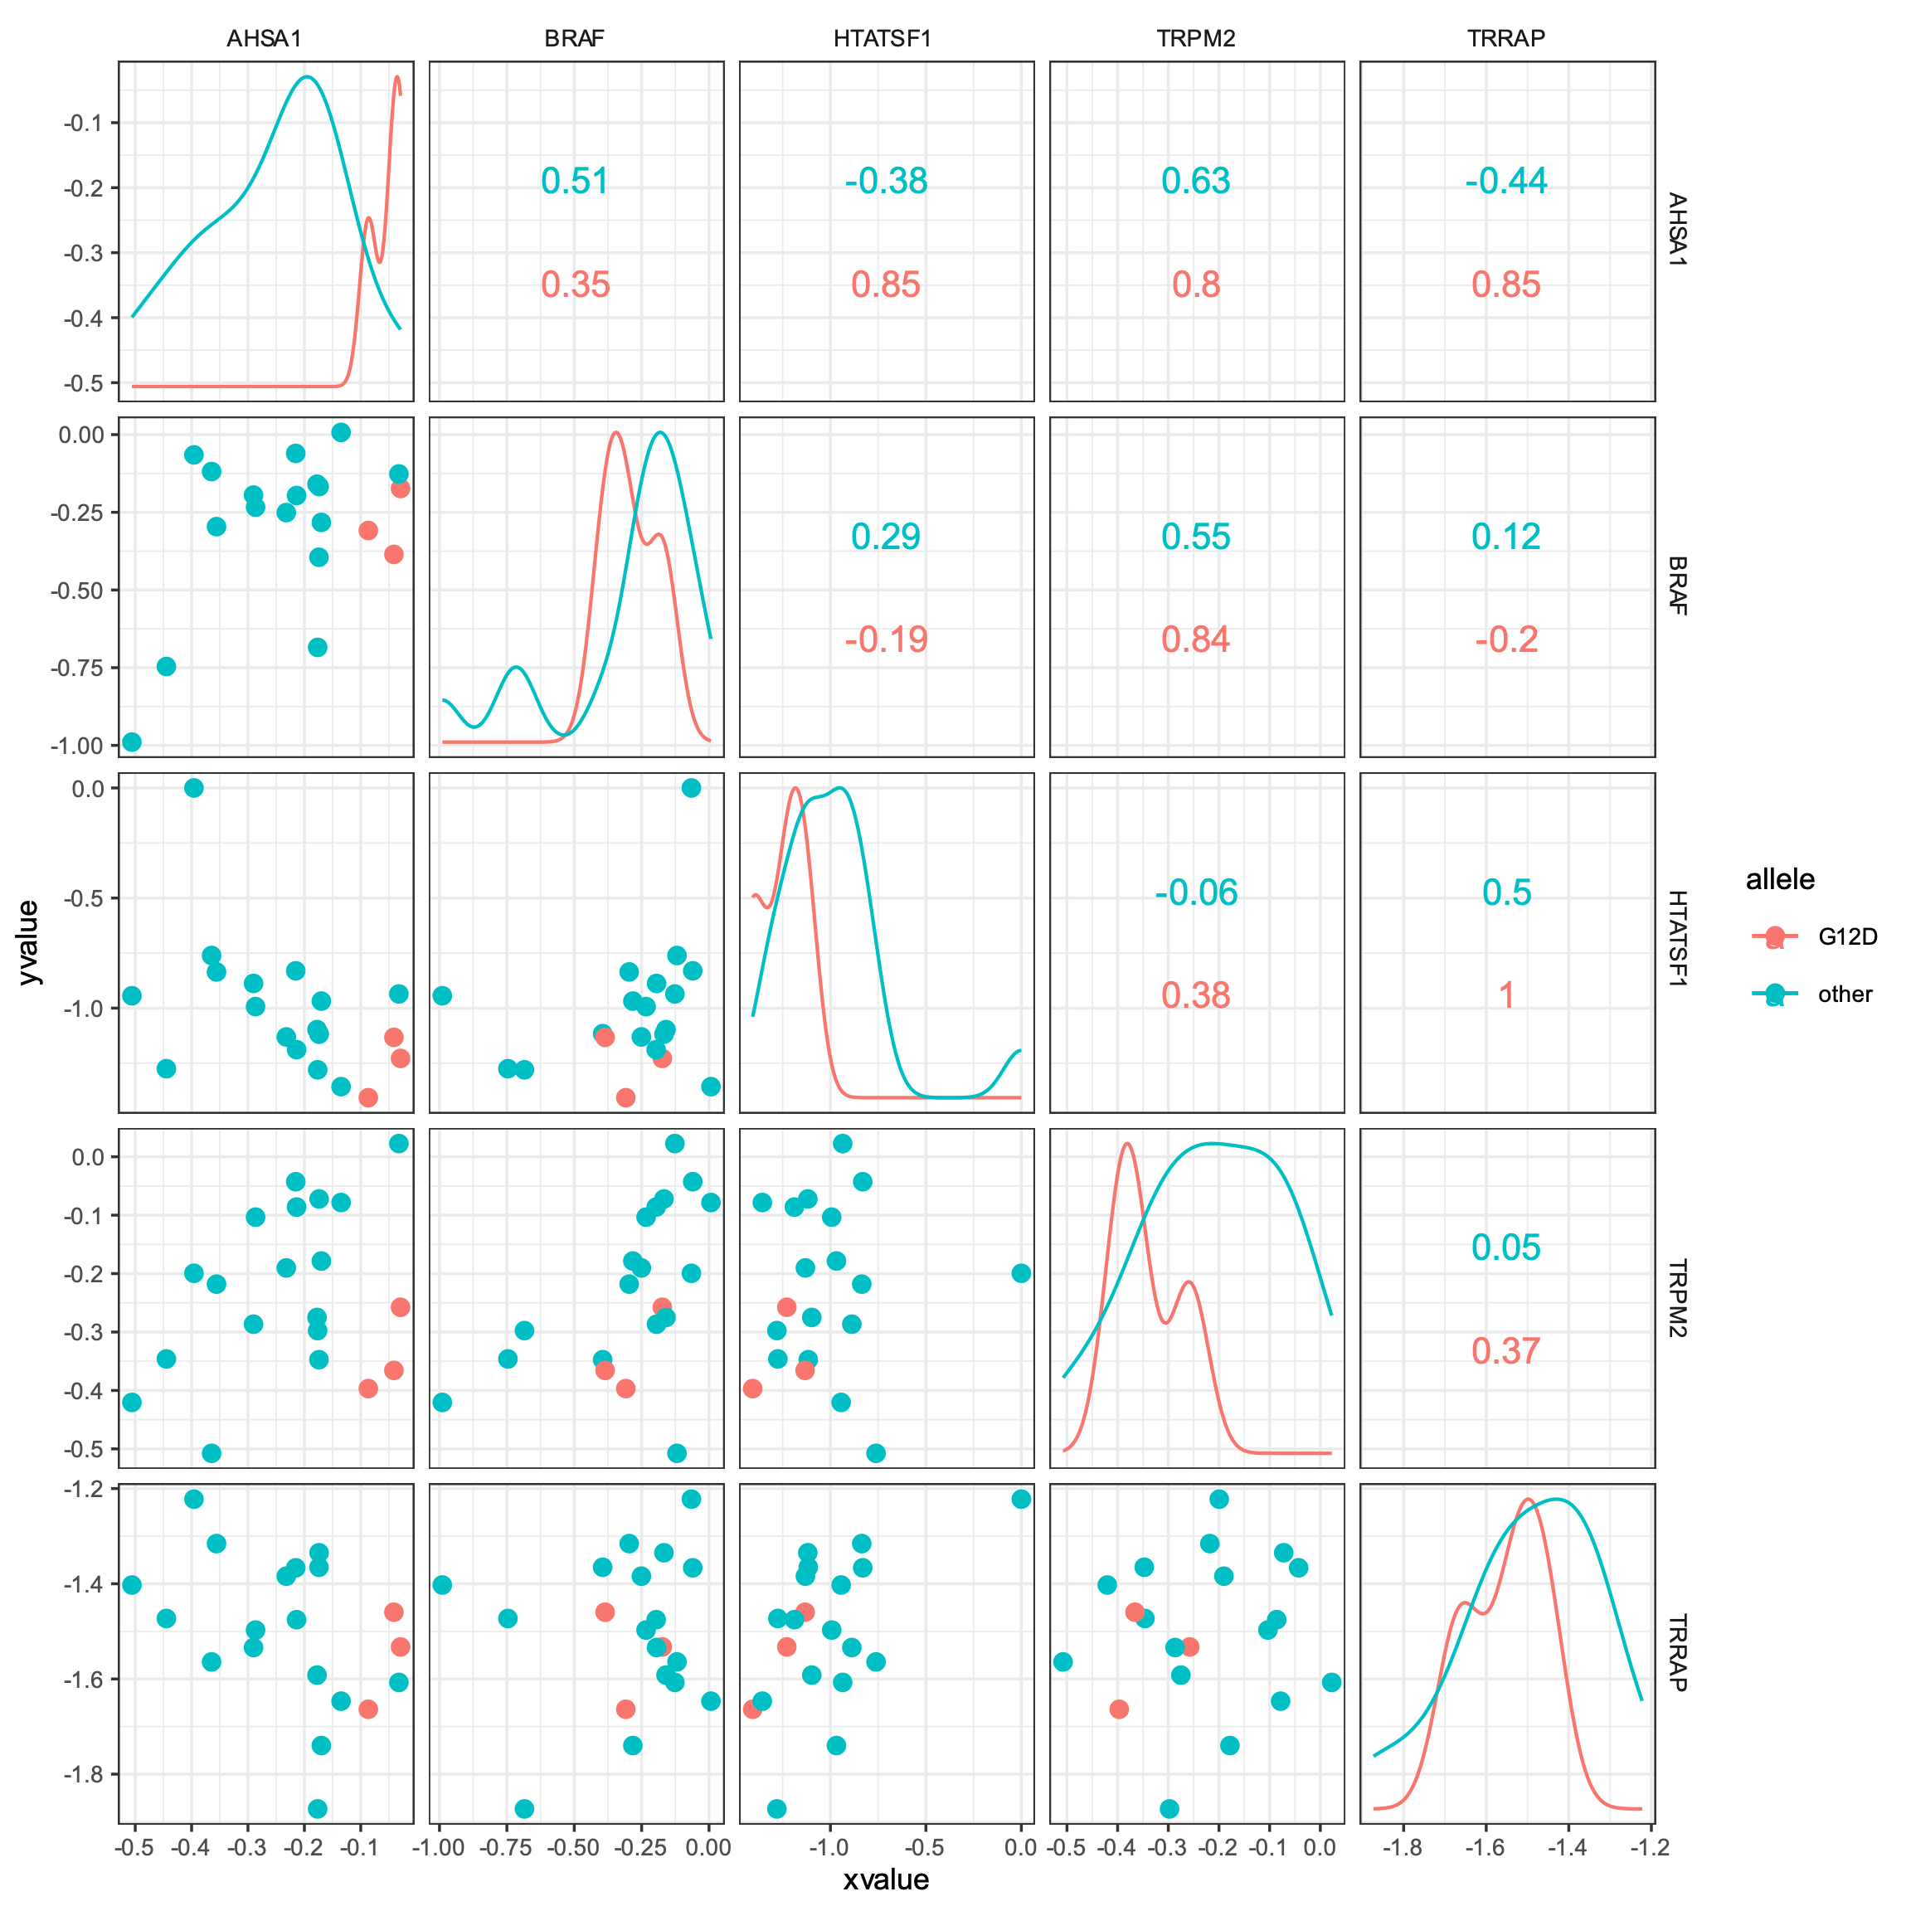
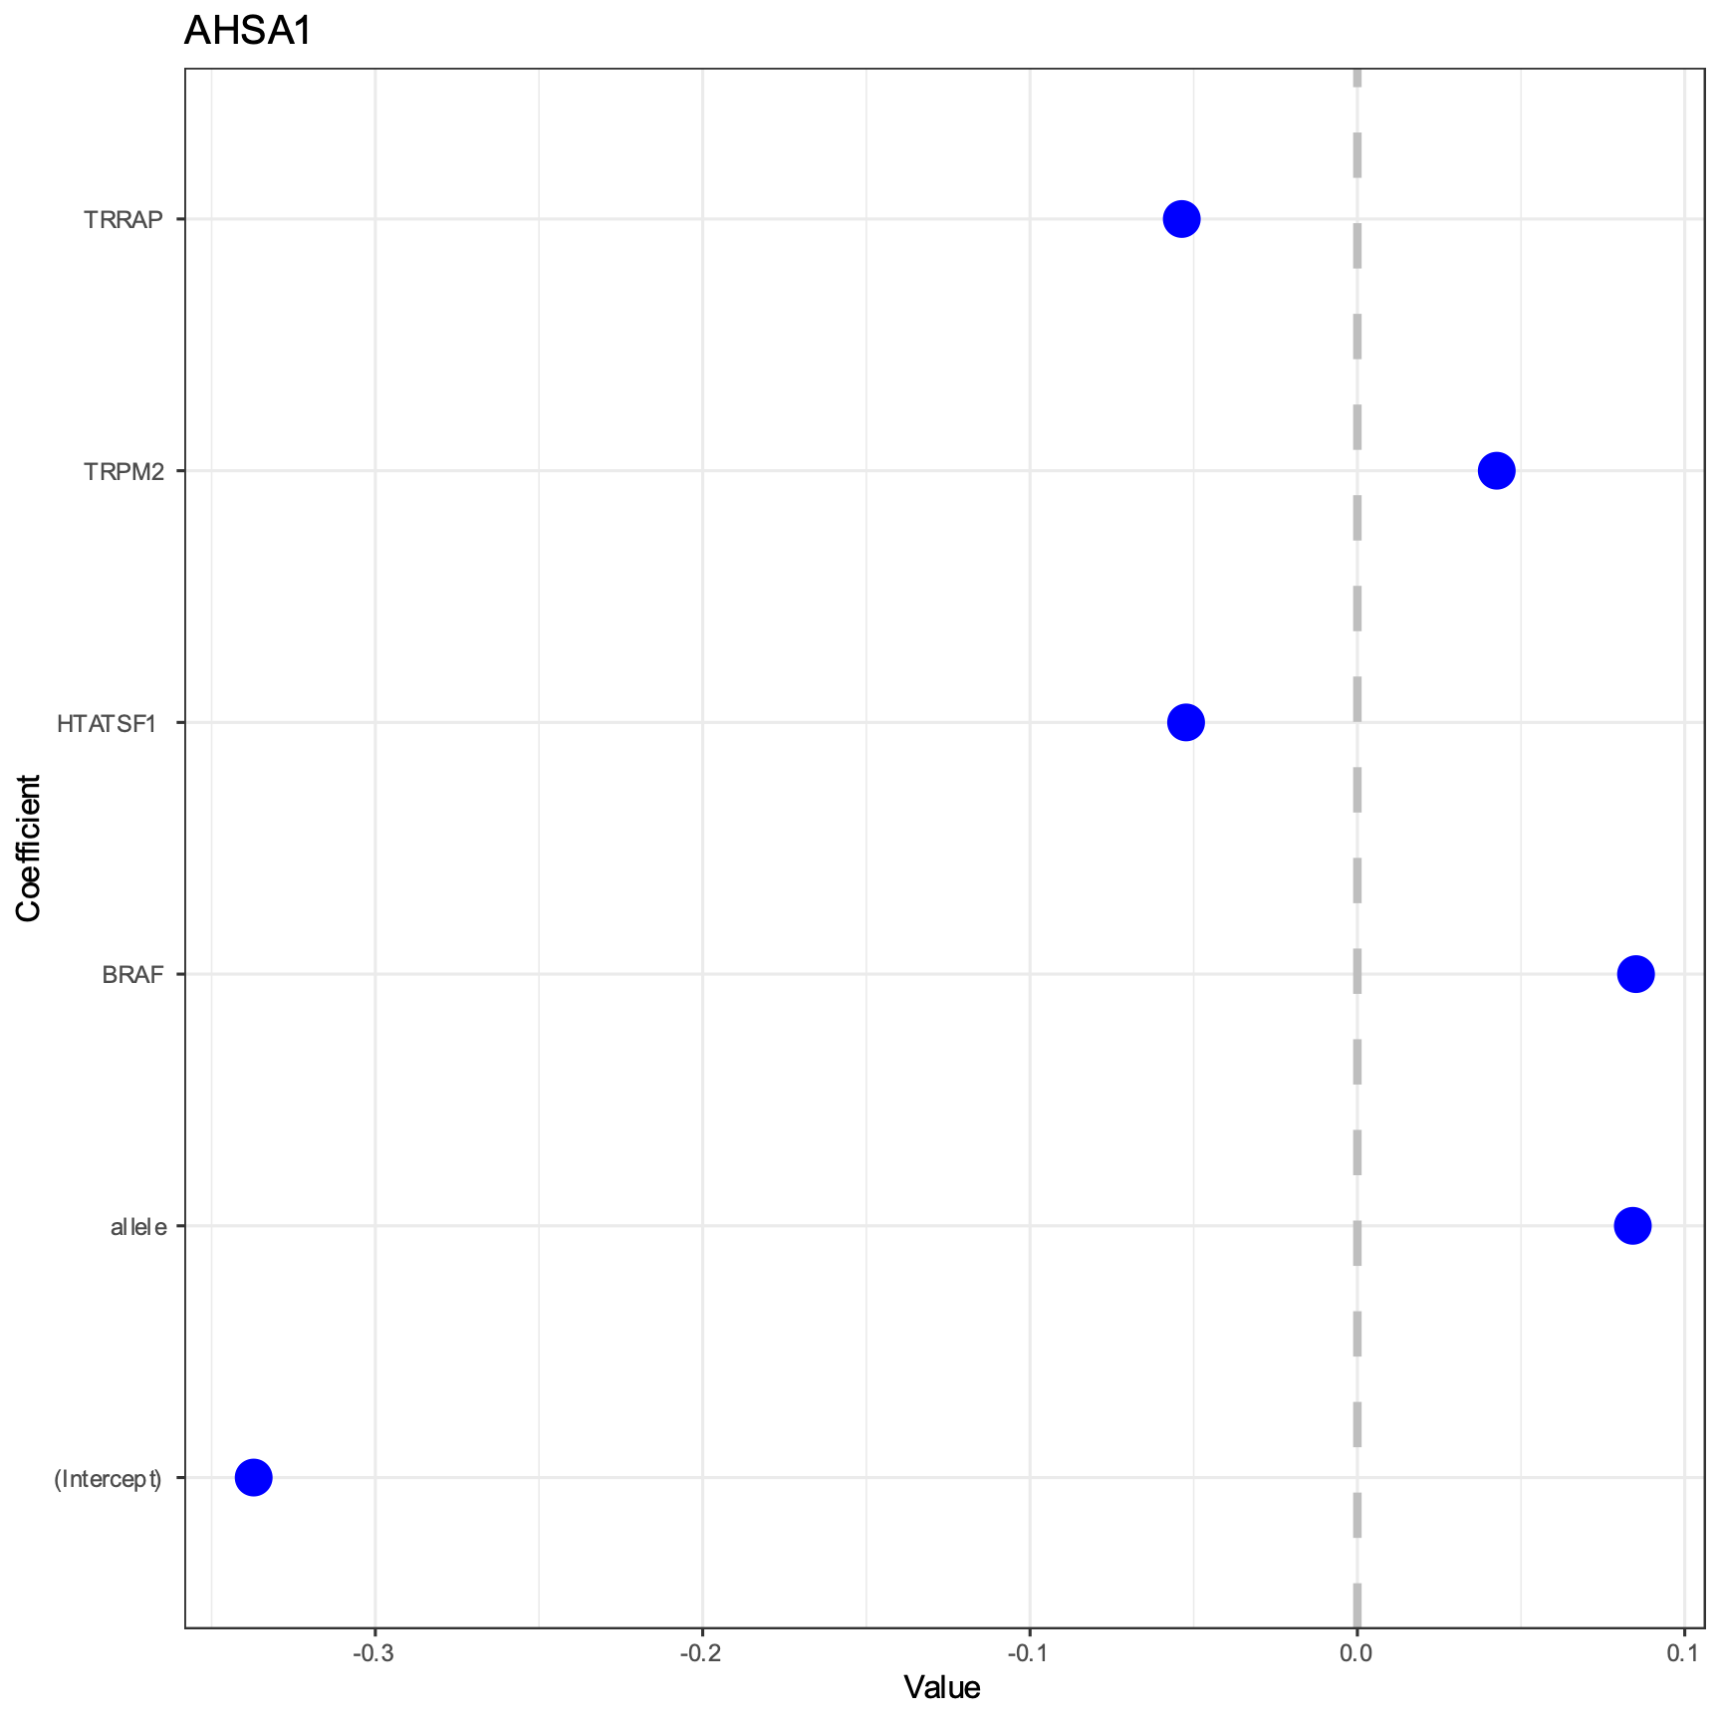

Slide 12
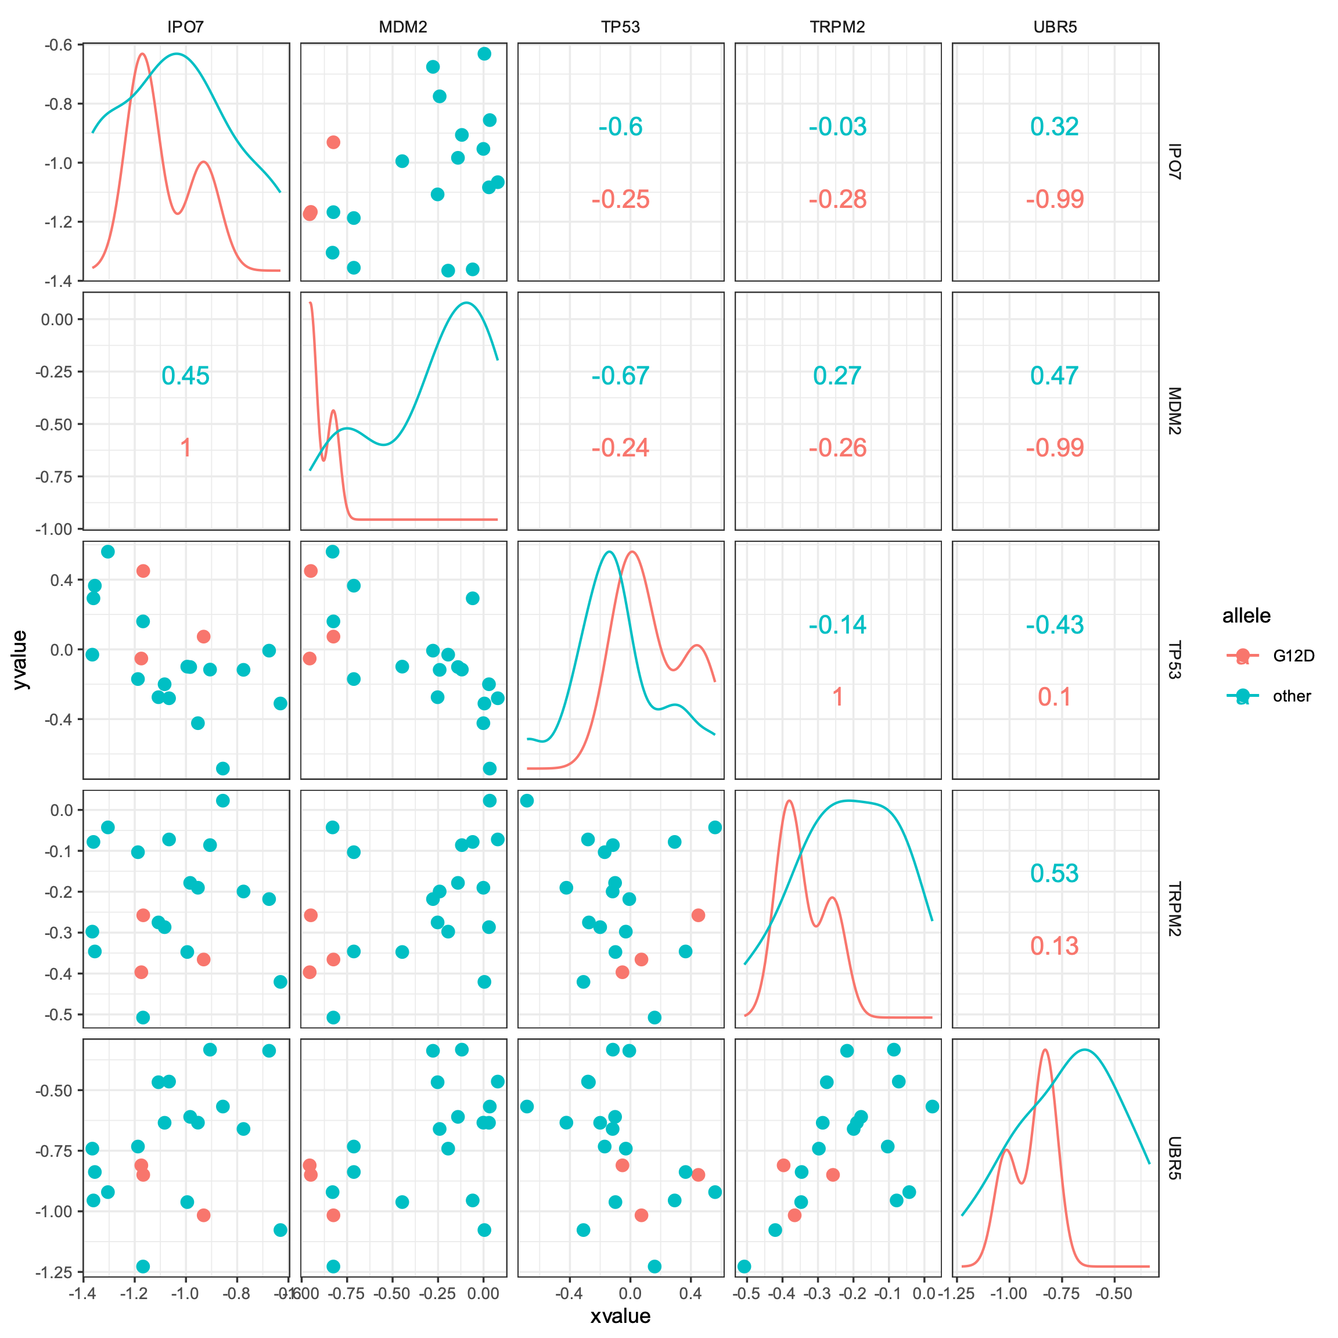
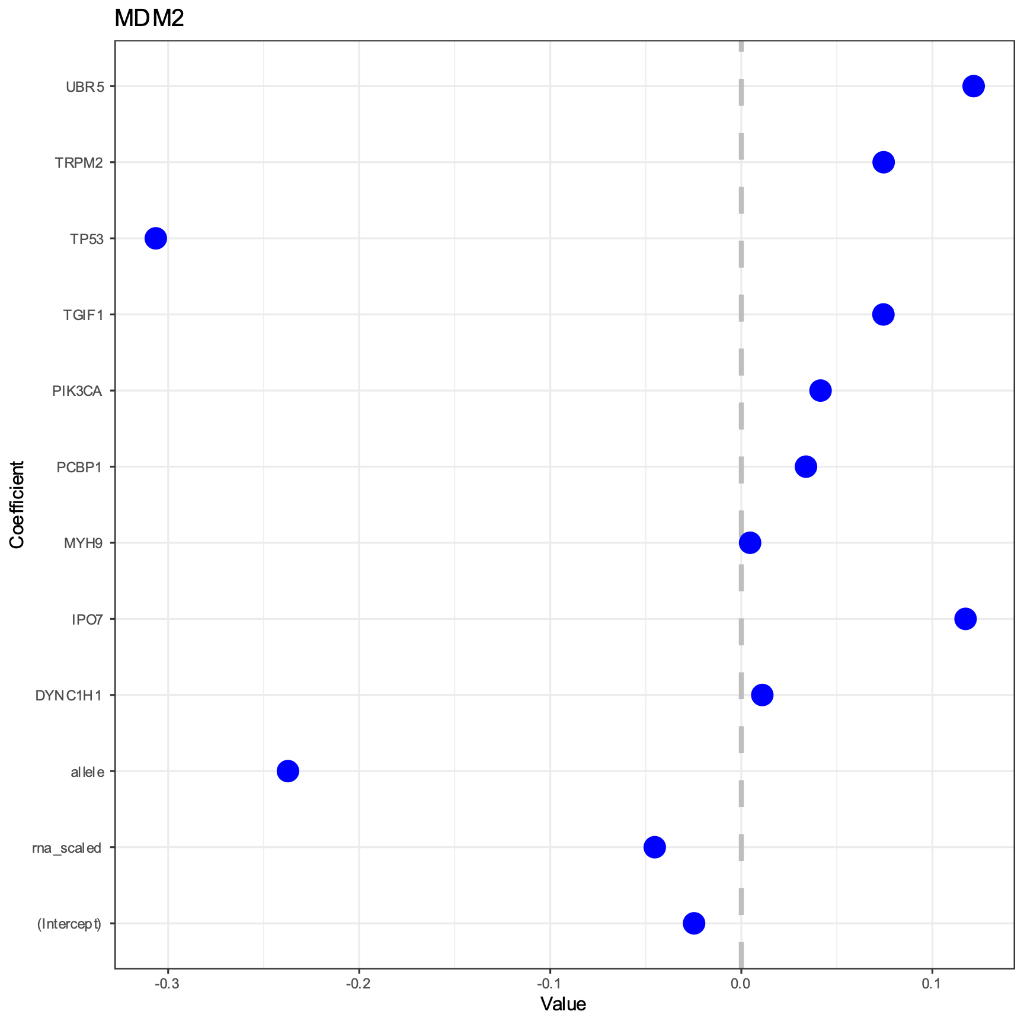

Slide 13
